Slide 1

SRM INSTITUTE OF SCIENCE AND TECHNOLOGY
COLLEGE OF ENGINEERING AND TECHNOLOGY
DEPARTMENT OF NETWORKING AND COMMUNICATIONS
18CSP109L/18CSP111L MAJOR PROJECT
SMS Spam Detection using Natural Language Processing and Ensemble Learning
Student 1 Reg No : RA1911030010100
Student 2 Reg No : RA1911030010071
Batch ID: NWC071100
Guide name and Designation : Dr. C. Fancy
Assistant Professor

Slide 2
Table of Contents
Abstract
Introduction
Motivation
Literature Survey
Challenges and limitations in existing system
Objectives of the project
Innovation Idea
Scope and application of the project
Architecture
Proposed Modules and their descriptions

Slide 3
Abstract
SMS Spam is sent by scammers trying to phish on people where they send a message to the victim saying that they have won something and want the victim to click on a malicious link to steal data or access the victim’s device. By creating multiple models for spam detection and combining the best performing models using ensemble learning techniques would give us a model which would predict a text message from spam and legitimate with much more accuracy. The model will be integrated into image steganography tool to hide message and keep it more secure in transit.

Slide 4
Introduction
Ensemble learning is a type of learning in AI/ML where multiple different models are used and then their different outputs are combined to give a final result.
By using the concept of ensemble learning, we can train multiple models and choose the ones with very high accuracy and precision and use those models together to get a model which gives a more accurate prediction.
As SMS has turned into MMS nowadays, sending images with hidden text using steganography can be used to provide another layer of security in text messages.

Slide 5
Motivation
Everyone gets annoyed when they receive spam text messages from time to time and clutter chat logs on messaging app. Sometimes people even fall for spam texts thinking they are legitimate and less educated and senior citizens are much more prone to this. By determining if a message is spam, the user can ignore and delete the message. Implementing this model in the sms application by integrating it with an image steganography tool will give an extra layer of security when in transit.

Slide 6
Literature Survey
S. No. | Name | Techniques Discussed | Conclusion | Limitations
1 | Improving Static SMS Spam Detection by using New Content-based Features | Linguistic inquiry and word count | Counts the number of common spam categorized words | Dataset skewedness highly impacts the accuracy of model
2 | Content Based SMS Spam Filtering | Bayesian filters like SpamAssassin | Gives 97% accuracy | Accuracy can be increased with ensemble learning
3 | Deep Learning to Filter SMS Spam | CNN models | Model gives 96% accuracy | High computation

Slide 7
Literature Survey
S. No. | Name | Techniques Discussed | Conclusion | Limitations
4 | Spam Detection in SMS Based on Feature Selection Techniques | Applied Information Gain technique instead of chi square | Feature extraction gives a slight increase in accuracy | Only Naïve Bayes and SVM algorithms were used
5 | The Impact of Feature Extraction and Selection on SMS Spam Filtering | Chi square and gini index | Message length, presence of url taken in account | Spelling and capitalization affects the model
6 | A Review of Feature Extraction Optimization in SMS Spam Messages Classification | Removing common occurring spam keywords, url links, monetary symbols | Gives model more parameters | Spelling and capitalization affects the model

Slide 8
Literature Survey
S. No. | Name | Techniques Discussed | Conclusion | Limitations
7 | Rule-based framework for detection of smishing messages in mobile environment | Created rules such as fake url, advertising messages. | 9 Rules created by authors showed that stopwords are most efficient | Many more rules could be added to increase the efficiency
8 | A Constant Time Complexity Spam Detection Algorithm for Boosting Throughput on Rule-Based Filtering Systems | Used hashes of words and compared to rules. | Increase in number of rules increased with time consumed | Multiple rules on a huge dataset would take a lot of time
9 | A practical rule based technique by splitting SMS phishing from SMS spam for better accuracy in mobile device | Rules for splitting messages in two groups | Used rules focused on messages if they contain the word winner or are ads | Only two rules is not enough for detection of spam and further processing will need to be done

Slide 9
Literature Survey
S. No. | Name | Techniques Discussed | Conclusion | Limitations
10 | Detecting Streaming of Twitter Spam Using Hybrid Method | Decision trees and genetic algorithm | Combined 2 models | New models accuracy depends on the performance of the other two
11 | A hybrid CNN-LSTM model for SMS spam detection in arabic and english messages | Tf-idf, cnn | Combining cnn and lstm gives a model with 96 accuracy | Training model takes a lot of computational resources
12 | Hybrid SMS Spam Filtering System Using Machine Learning Techniques | Naïve bayes, svm, linear regression | Tuning svm with tf-idf have 100% precision | Naïve bayes will be a better model in most cases

Slide 10
Challenges and Limitations
While combining the multiple models, we will need to choose the ones such that the accuracy does not decrease with keeping the precision of the model as high as possible as well. And even after creating the model, the model would still need constant training on new dataset including data generated and classified by the user themselves. Even after creating the model, it has been done so many times that attackers come up with newer phishing techniques. To prevent this, we implement an image steganography tool which can help double the security of the message while in transit.

Slide 11
Objectives of the project
The main goal of this project is to create an ensemble model with higher accuracy than its base models without losing precision of the model. Using the models that give 100% precision, we would take them as base models such that the final model can classify text messages as accurately as it can while avoiding false negatives. SMS apps can be modified such that instead of sending encrypted text messages, they send text messages hidden in images. The app would hide the text message in the image while transmitting it and will de decoded when received, even if an attacker figures it out the spam detector model will catch the message.

Slide 12
Innovation
The SMS spam detection models that have been previously created have not been created using ensemble learning techniques, i.e. current models have only been used creating Naive Bayes algorithm. By using AI model for spam detection and coupling it with image steganography to send modern sms messages so that they are harder to decrypt. Even if they are implemented in applications, they are only detecting spam and not preventing it. By creating an image steganography tool with the AI model, the text message will be hidden in an image, also providing security over the already encrypted text channel.

Slide 13
Scope and Application
The dataset will be preprocessed and features will be extracted such as number of words, letters and sentences. The words of texts will be stemmed and removing the stopwords after which the dataset will be trained on different Naive Bayes variants and the best performing model will be selected as the base models and other models including Random Forest, K nearest neighbors and more will be tested and the best performing models will be selected for the ensemble model. The model will be hosted on railways platform through streamlit library.
The application of this project is to create an interface where user can copy the text and the website hosting the model will predict if the text is spam or not.

Slide 14
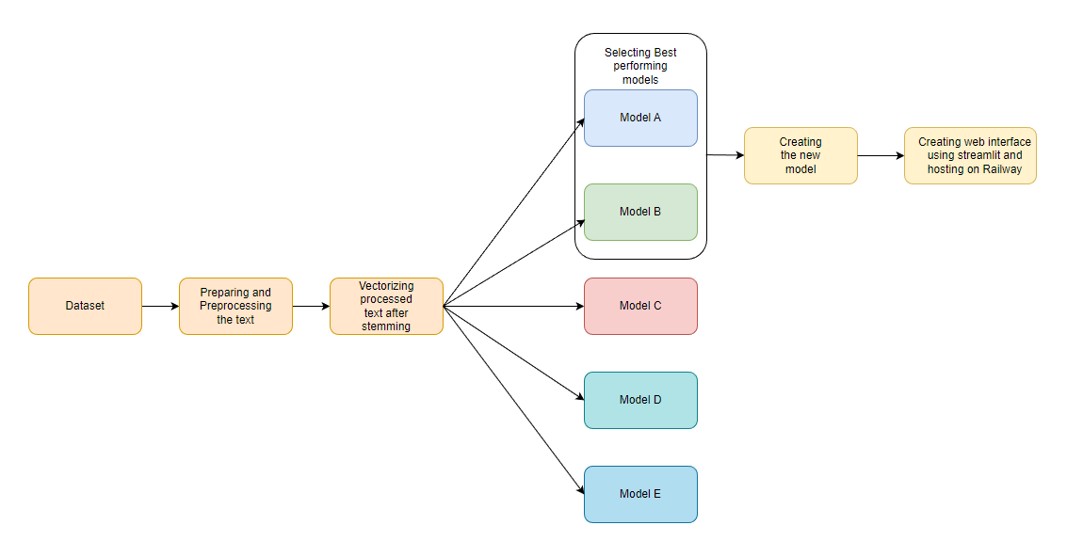
Architecture

Slide 15
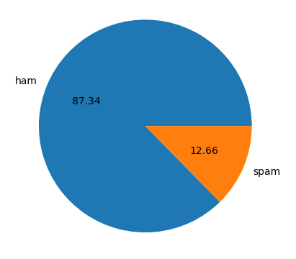
Proposed modules
The dataset was preprocessed and the dataset had 87.34% ham messages and 12.66 spam messages.Exploratory data analysis showed the common words shown in spam and ham messages and after performing feature extraction it was found that ham messages had lesser words, letters and sentences as compared to spam messages. 10 algorithms were used to train 10 models and then optimised by changing parameters and best performing models were assembled into a custom model.

Slide 16
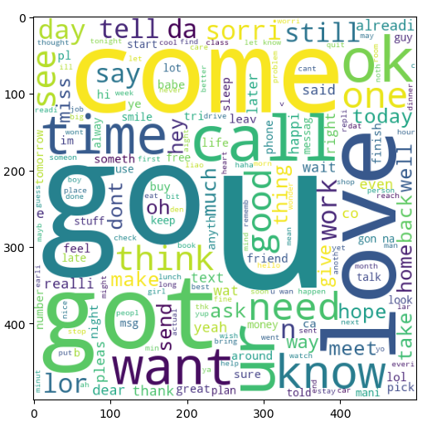
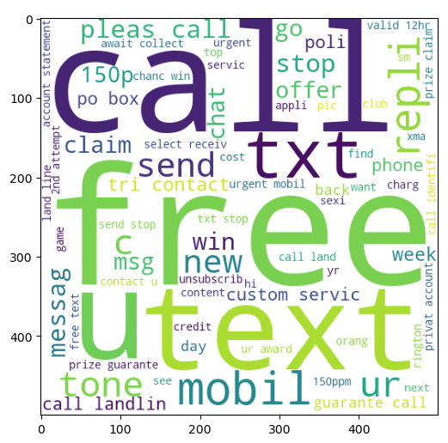
Proposed modules
Common words in Legitimate texts Common words in spam texts

Slide 17
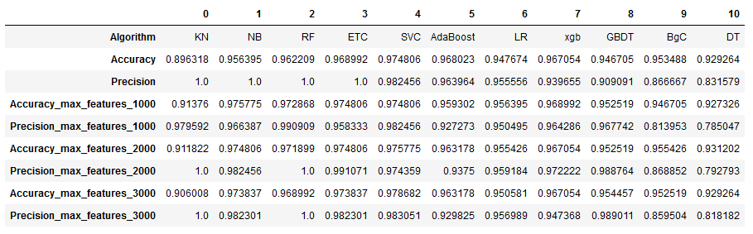
Proposed modules
Results of the trained models with different values of max_features in TF-IDF

Slide 18
Proposed modules
As for the security module, we created an image steganography tool that uses 1-bit least significant bit shifting method and integrated the custom ensemble model. When the sender wants to send some confidential information, they can hide it in an image and send it over the sms application, this provides a layer of security as even if an attacker tries to catch the messages, they would have to break the message encryption and then break the image encryption as well, and if they crack it and embed a spam url or spam message on an image, the model on the receiver side can decrypt the message and label it as spam and ham accordingly.

Slide 19
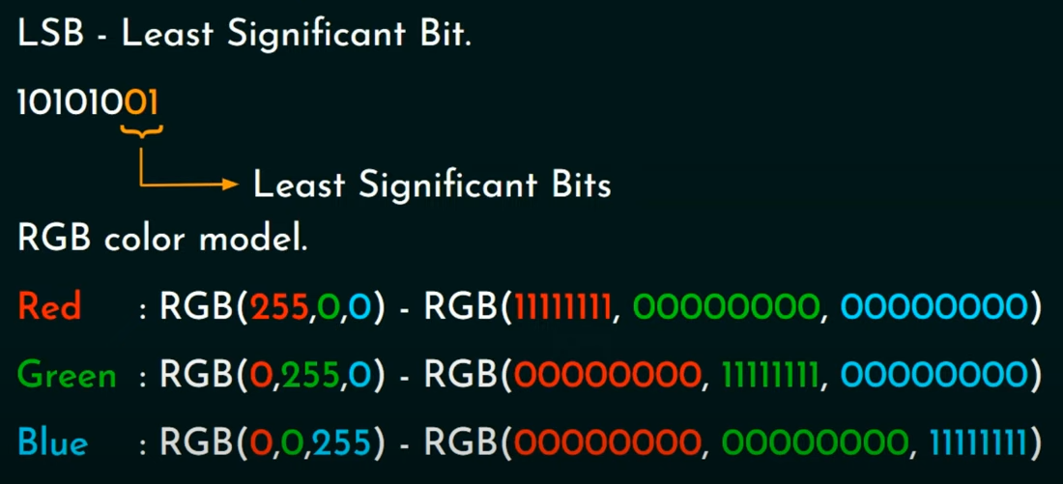
Proposed modules

Slide 20
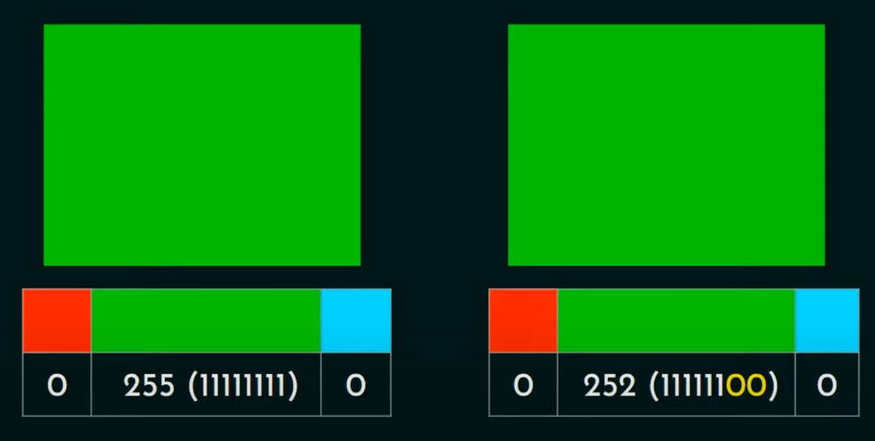
Proposed modules

Slide 21
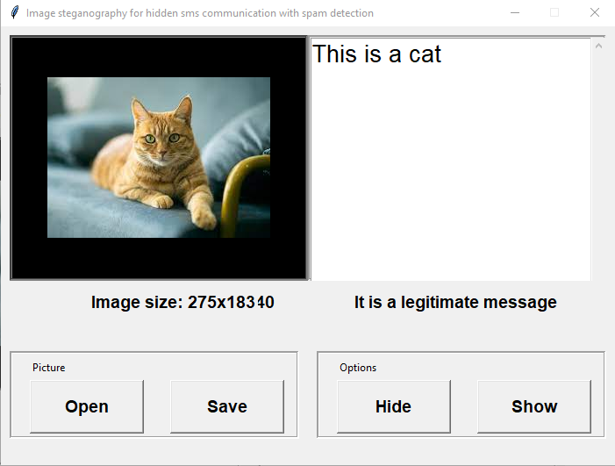
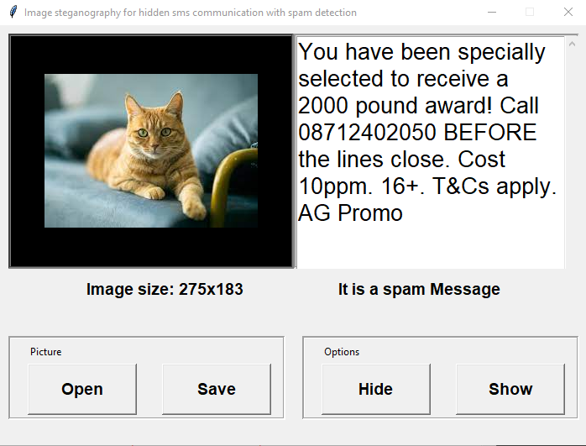
Proposed modules
Legitimate Message Spam Message

